Slide 1
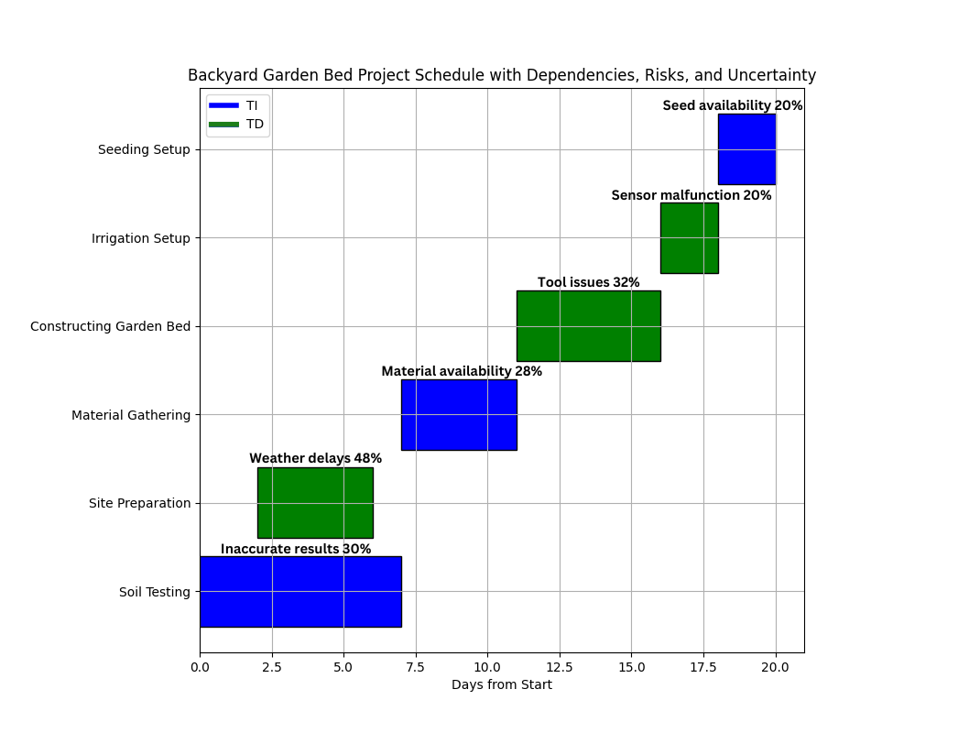
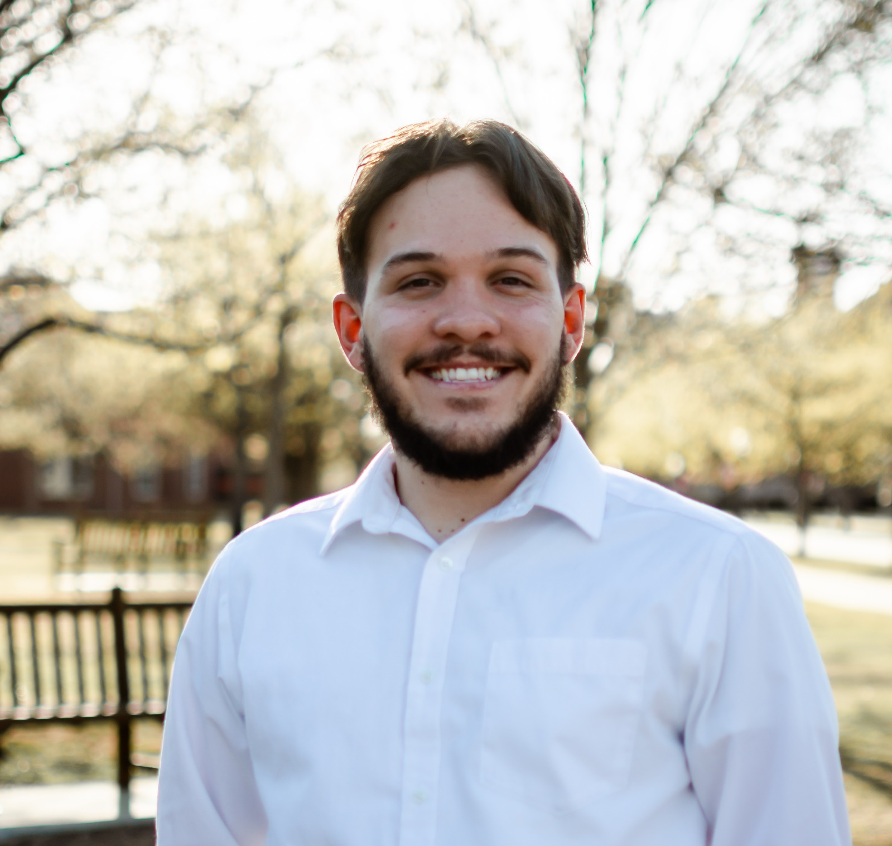
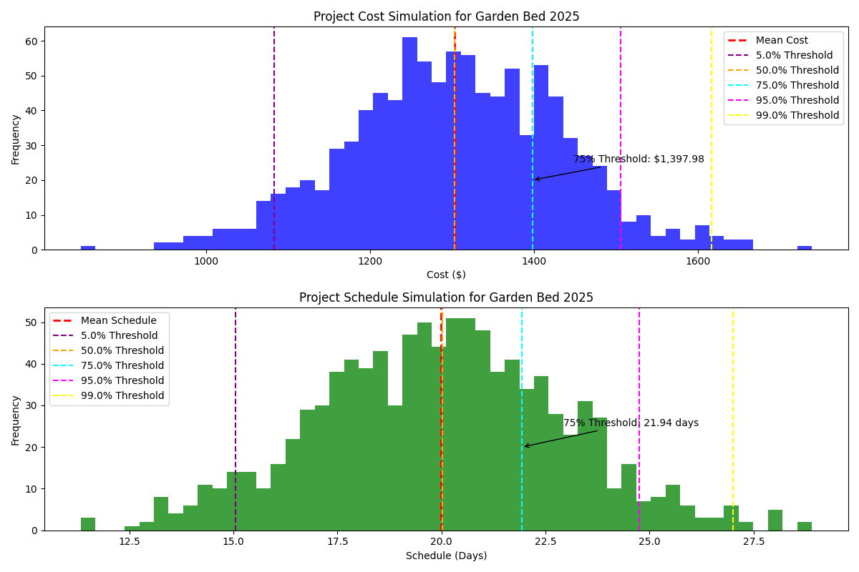
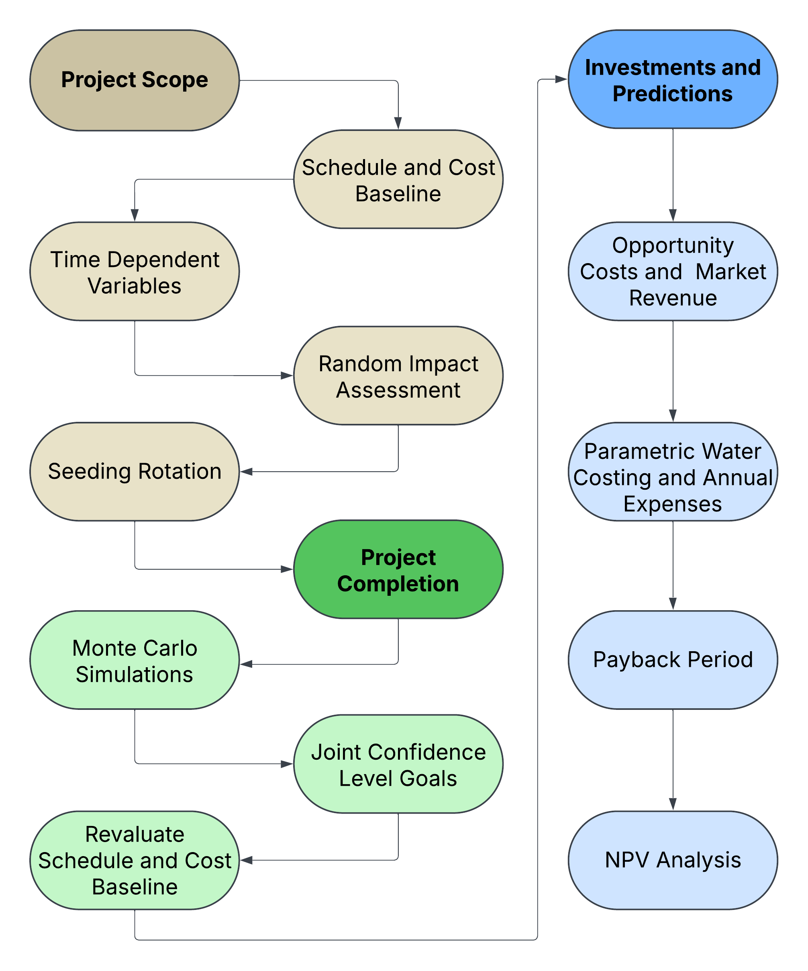
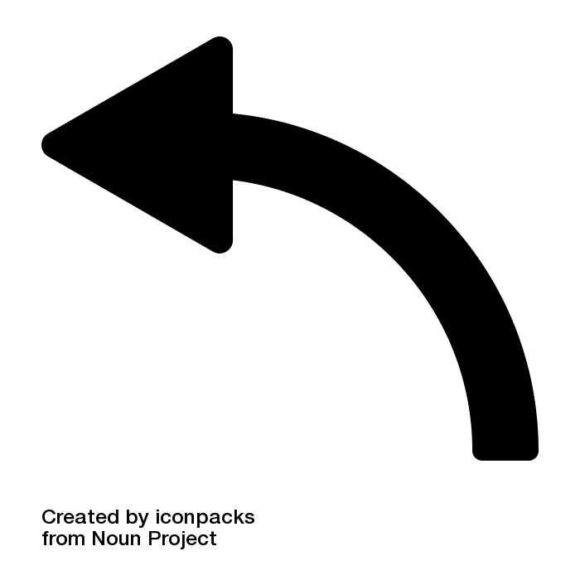

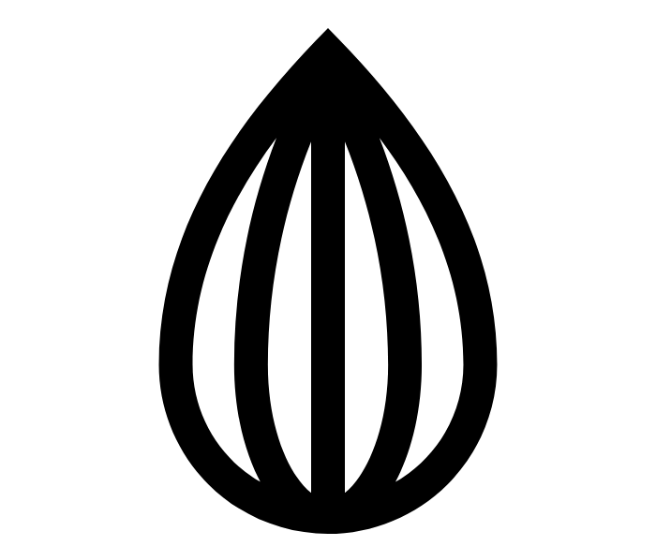
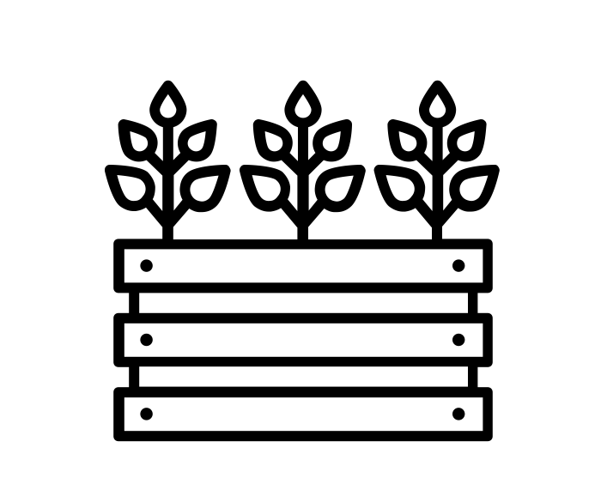
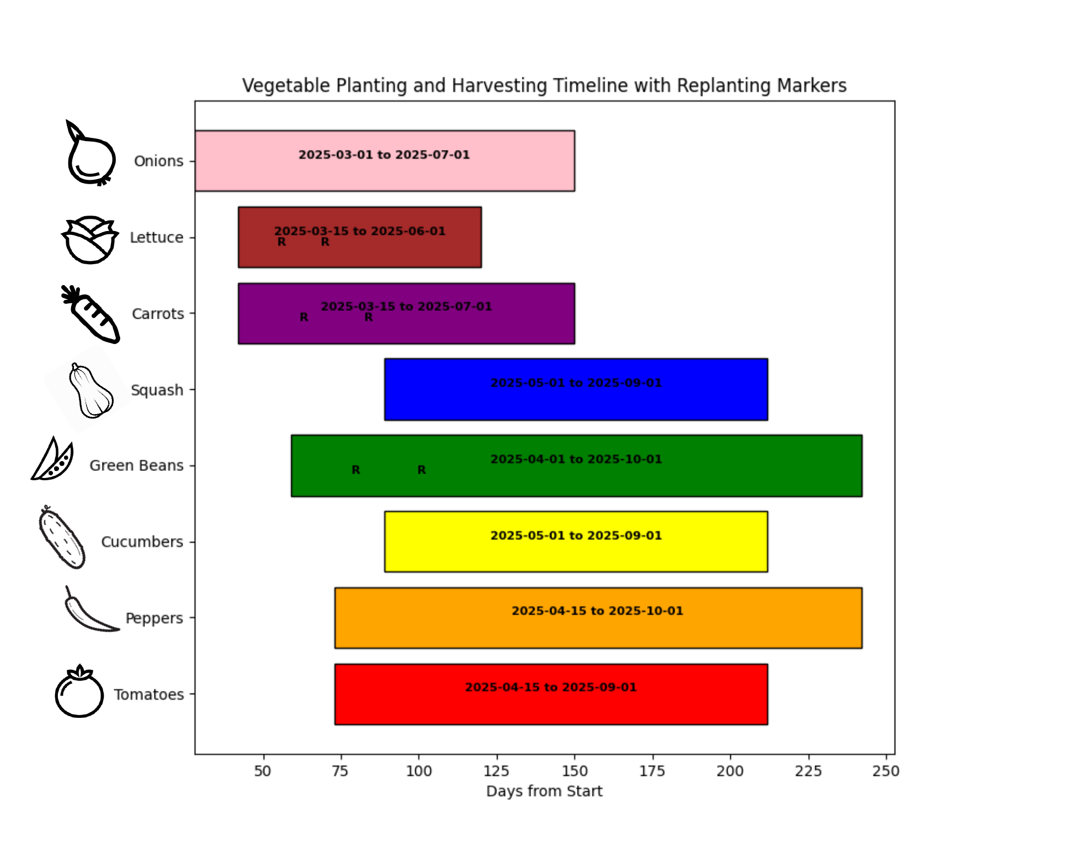
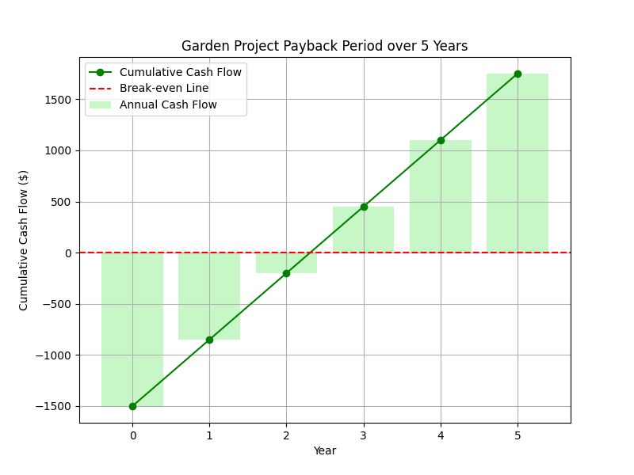
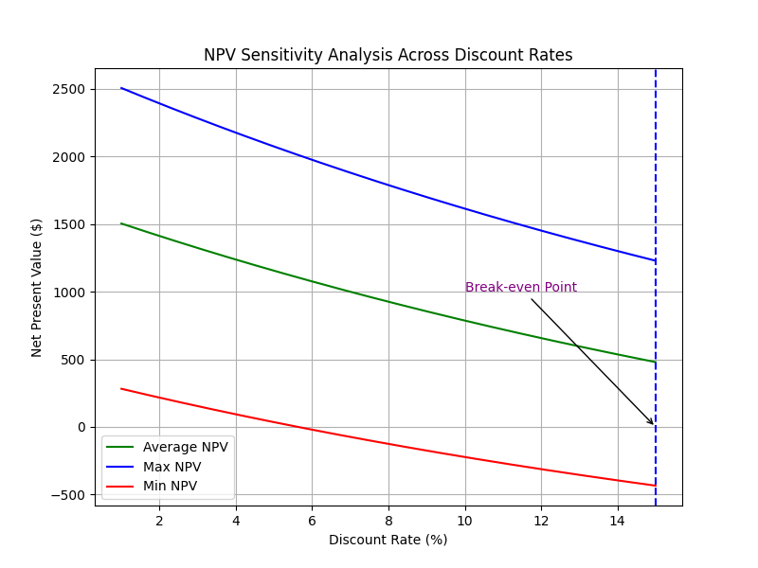
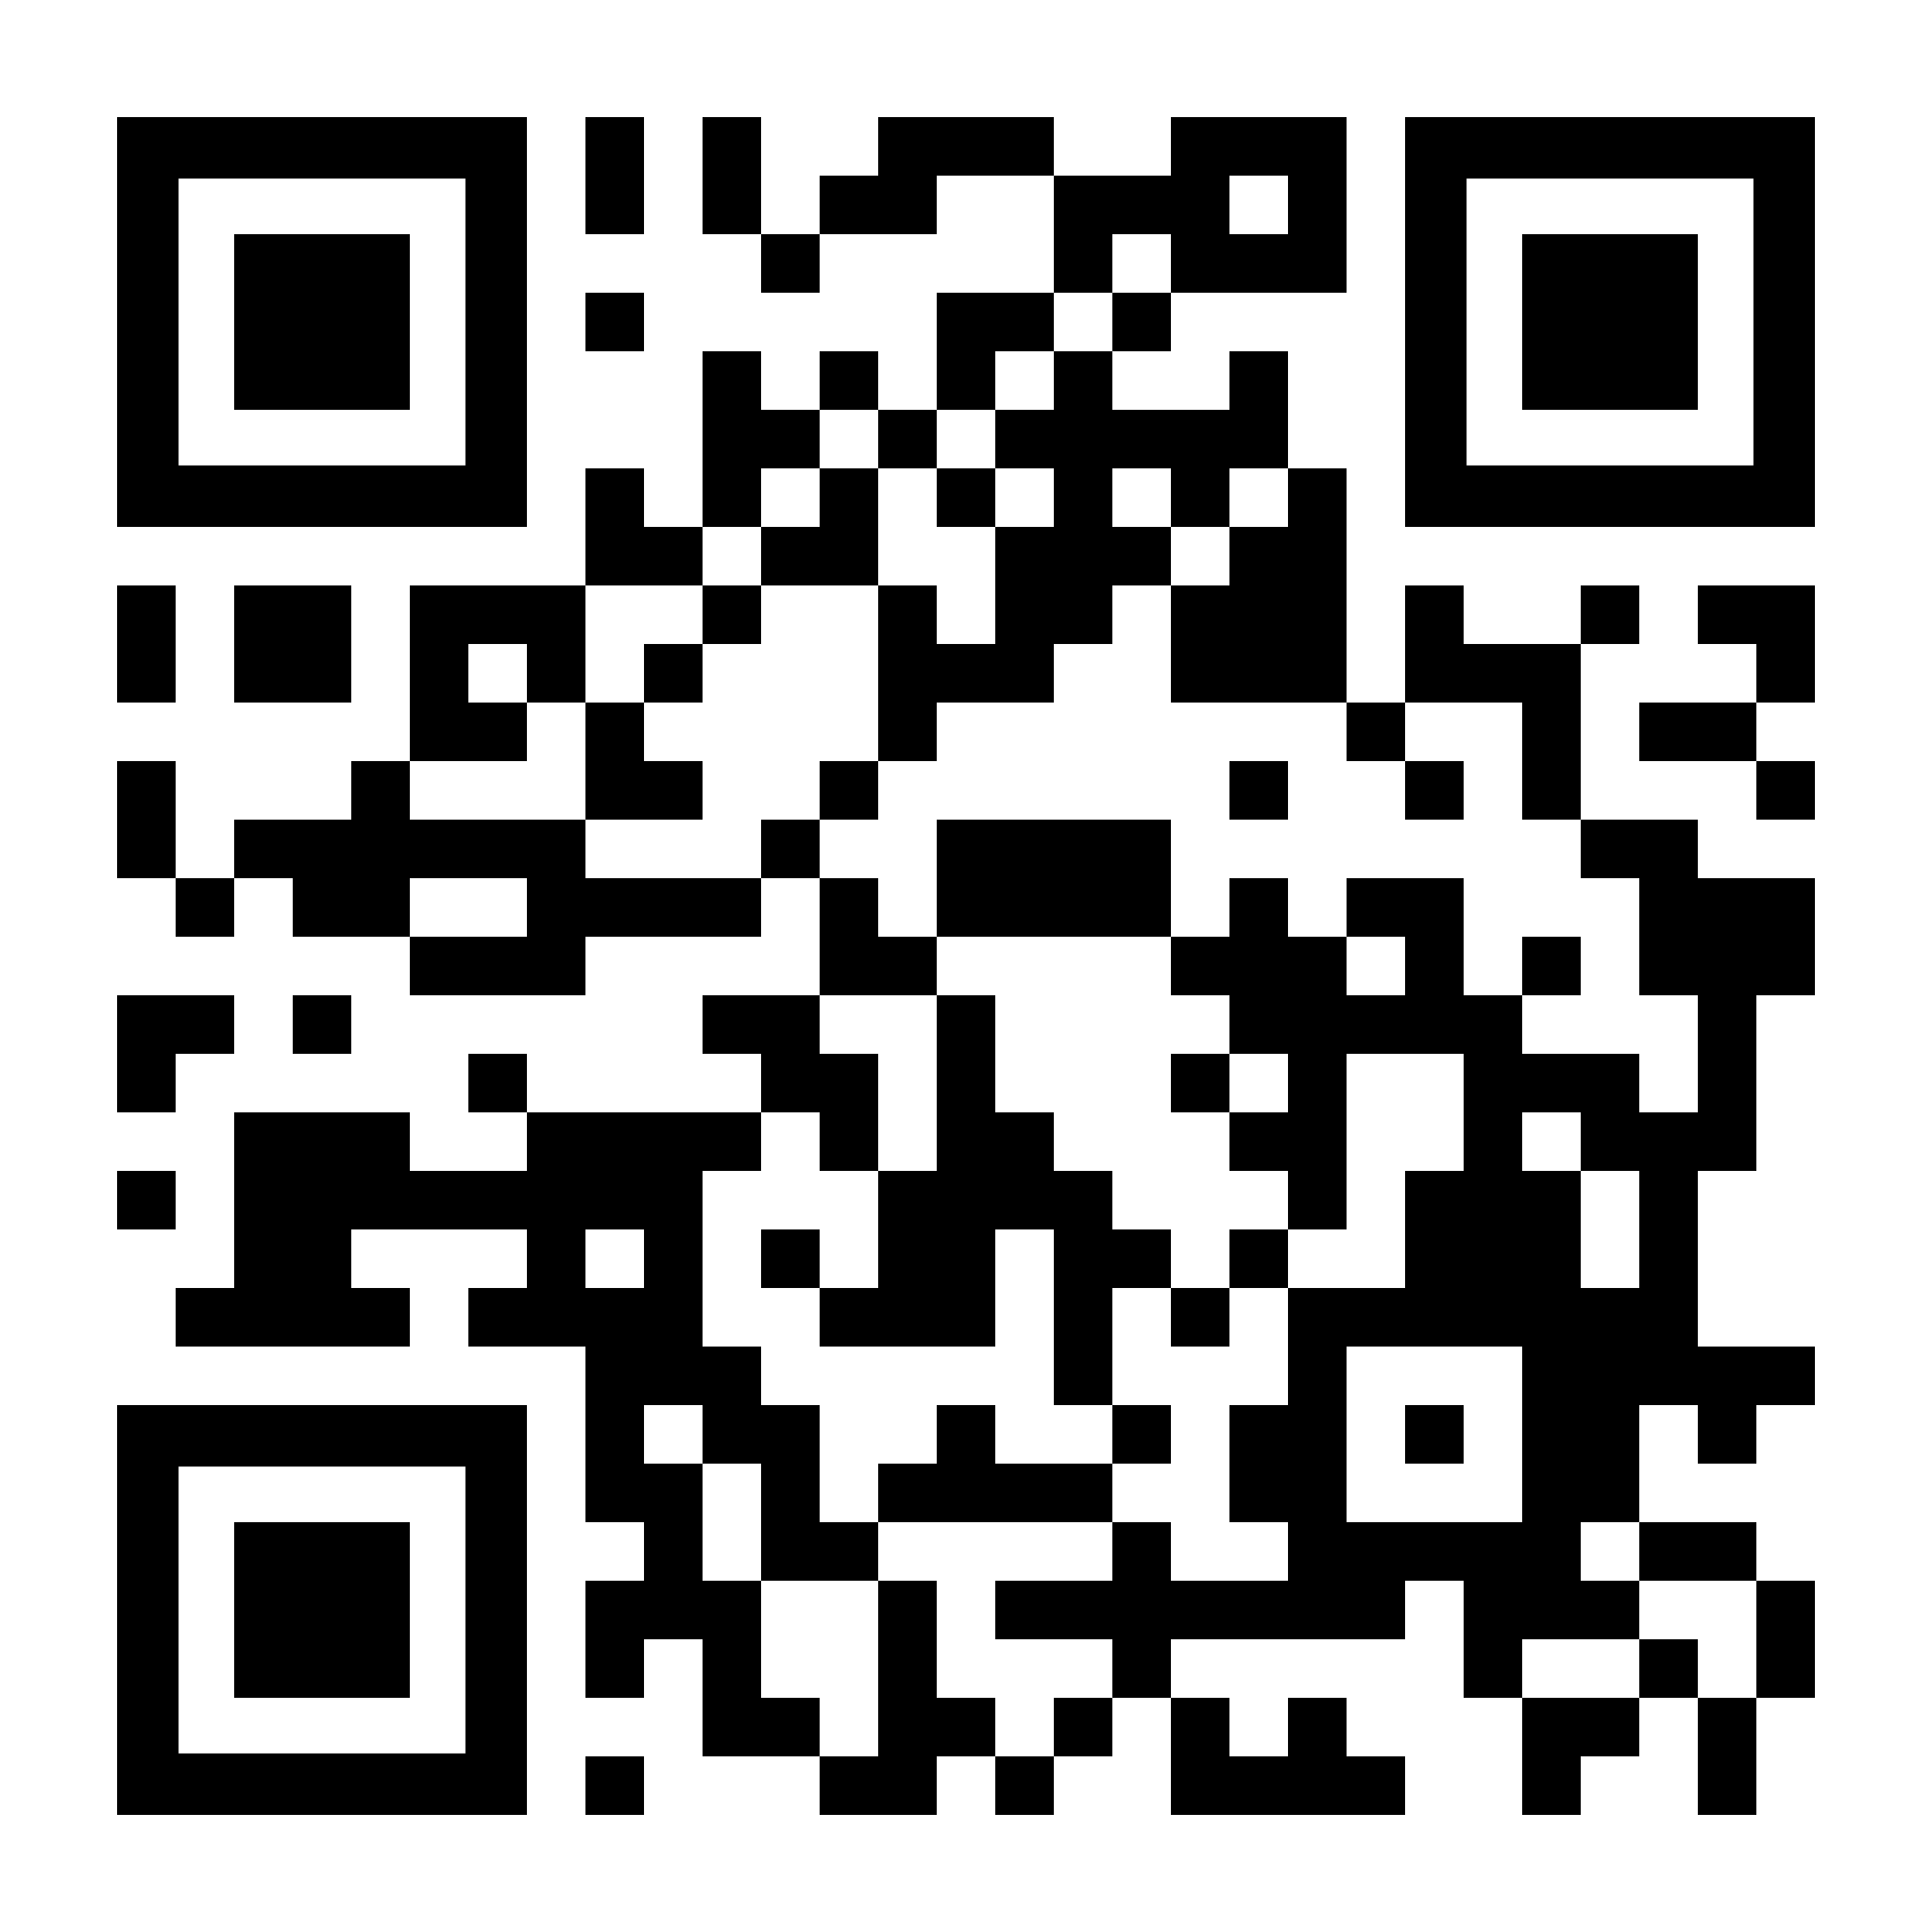


Majority of Oklahomans could reliably net a healthy positive income on garden bed investments… just after 3 years
Non-Cognitive Predictors of Student Success: A Predictive Validity Comparison Between Domestic and International Students
Vegetable Garden Investments in Oklahoma
Dawson McClary
ELM Masters Program
BACKGROUND: Vegetable gardens provide abundant food resources, and initial investments could turn positive over time. Based on Oklahoma geography and weather, we simulate a scenario for a garden bed project starting in February 2025 and discuss timeline, risk, budget, and sustainability.
METHODOLOGY
RESULTS
Initial investment of $1400 and 20 days for project completion gave JCL of 56.4%
Weather delays and material availability pose an average 35% risk to meet goals
Analogous costing for mulch, seed, and annual water expenses lower yearly costs
NPV Analysis using min and max cost variance proved project sustainability
DISCUSSION
Increased baselines to $1500 and 22 days to achieve JCL of 75% and avoid risk impact
Annual ROI after 3 years is 30%
Average NPV of the project remains positive for discount rates of 5% to 15%
Visit Oklahoma State University’s
Soil Analytical Laboratory to get started
on the first step to your investment!
Follow the attached QR Code for links to
OSU’s SWFAL
Copy of Project Poster
Python Script Calculations
Icons from Noun Project: Kim Sun Young, Made by Made, Suhansih Ningrum, Iconpacks
Notes:
Notes:
In Powerpoint, click View > Guides
Keep text within gutter guides.
Author list: Don’t split names onto two lines (e.g., “Jimmy [break] Smith”). If that happens, use a new line, unless you need the space. Bold the first names of anybody who’s presenting in person.
Intro/methods/result: Do not drop below font size 28, but if you have extra space, jack up the font size until the space is full.
Do not use color in the sidebars except in graphs/figures. It’ll pull attention from the center and slow interpretation for passersby.

